Slide 1
Eimeriidae

Slide 2
Taxonomic Consideration
Phylum: Apicomplexa
Family: Eimeriidae
Subclass: Coccidia
Suborder: Eimeriina
Genus: Eimeria
Species: acervuline mivati necatrix
brunetti praecox brunetti
maxima hagani Tenela
mitis

Slide 3
What is the life cycle of Eimeria?

Slide 5
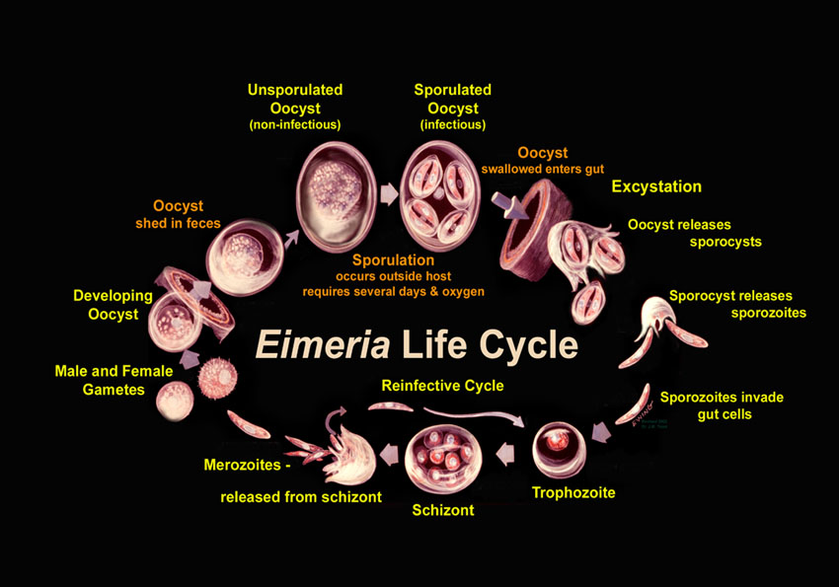

Slide 6
What is mode of infection?

Slide 7
Eimeria are transmitted via the fecal-oral route

Slide 8
Unsporulated Oocysts
Sporulated Oocysts
Optimal environmental conditions:
21-32 °C
Moist little
Sufficient oxygen

Slide 9
The Eimeria life cycle has basically two stages:
-The exogenous phase (sporogony)
-The endogenous phase (schizogony and gametogony)
-The initial infective unit of all Eimeria is the sporozoite stage, which is a banana-shaped motile cell

Slide 10
Is Eimeria a pathogen?

Slide 11
Yes, Eimeria species were divided into different pathogenic levels

Slide 12
What is the disease caused by Eimeria Species?

Slide 13
Coccidiosis

Slide 14
What is the site of infection?

Slide 15
E. acervulina
E. Mitis
E. mivati
E. Praecox
E. hagani
E. Maxima
E. necatrix
E. brunetti
E. tenella

Slide 16
Development of disease depends on:

Slide 17
Infective dose: number of sporulated
Oocysts ingested

Slide 18
Environmental factors: stocking density
size of the farm
quality of the litter
Ventilation system
presence of animals of different ages
anticoccidials

Slide 19
Host factors: Host genetics
concurrent disease
age
acquired immunity

Slide 20
What is clinical signs of coccidiosis

Slide 21
Sever diarrhea
Decrease feed and water consumption
Weight loss
Decease growth rate
Decrease egg production
High mortality ( Death rate)
Necrotic enteritis, this caused by Clostridium perfringes

Slide 22
How is Eimeria diagnosed?

Slide 23
Diagnosis is by fecal flotation to detect oocysts, often in combination with characteristic necropsy findings
Fecal flotation: a routine veterinary test used to diagnose internal parasites or worms. The test detects the eggs of mature parasites that live inside the body and pass their eggs to the outside by shedding them into the host's stool

Slide 24
Which veterinary drug treat coccidiosis?

Slide 25
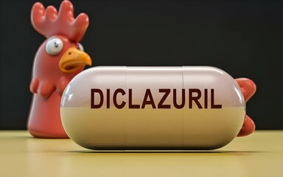
Diclazuril is highly effective against a broad spectrum of coccidia. It is used mostly for prevention at 1 ppm in the feed.

Slide 26
Control
Cleaning and disinfection
Batch depopulation
Good ventilation
Biosecurity
Antibiotics: sometimes given to prevent secondary infections
Depopulation involves ending the life of large numbers of animals due to emergency situations
Biosecurity refers to measures that are taken to stop the spread of harmful organisms to human and animal life

